Slide 1

STEWARDSHIP
MECH-24

Slide 2



Agenda
INTRODUCTION
COMPONENTS
SPECIFICATIONS
PROBLEM STATEMENT
ADVANTAGES
APPLICATIONS

Slide 3
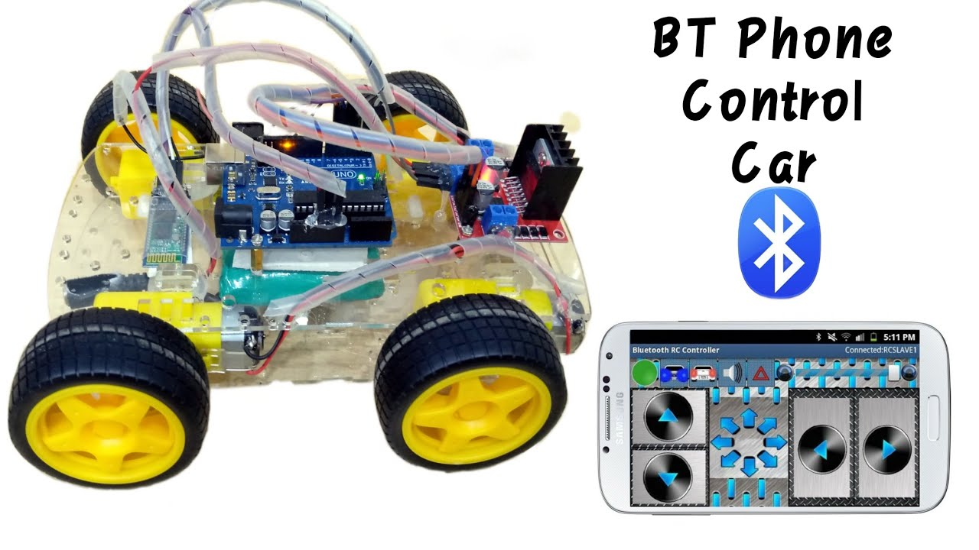

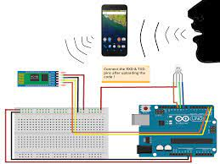
Introduction
It is through efficient electronic programming that a human can control a robot, hence a robot can be thought of as an Electromechanical machine.
Some of the essential characteristics that a robot must have are - sensing, movement, energy, intelligence. It performs a task using control systems, various power supplies and software all working together.

Slide 4

COMPONENTS

Slide 5
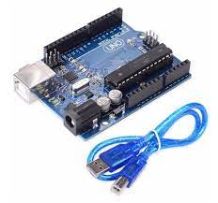
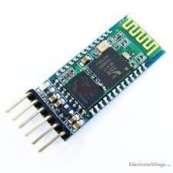
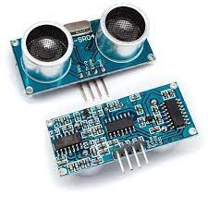

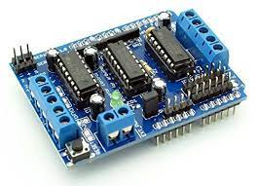
COMPONENTS USED
Name
Name
Name
Name
AURDINO UNO
MOTOR DRIVER
BLUETOOTH SENSOR
ULTRASONIC SENSOR

Slide 6
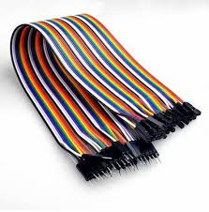
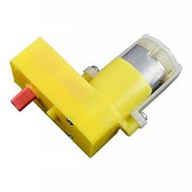

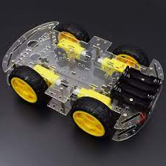
COMPONENTS
MOTORS
TYPE –DC MOTOR 3.7V
JUMPER WIRES
CAR CHASSIS
BATTERIES

Slide 7
SPECIFICATIONS
BLUEOOTH SENSOR
MODEL-HC-05
RANGE-10 MTRS
ULTRASONIC SENSOR
MODEL-HC-SR04
RANGE- 2CM TO 400CM
ARDUINO-UNO
MODEL-R3
VOLTAGE CAPACITY – 12V

Slide 8
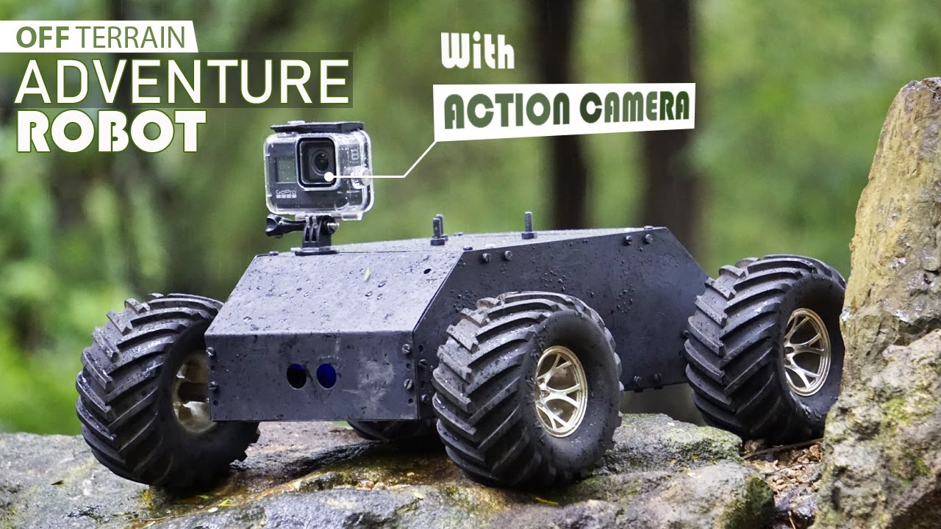
PROBLEM STATEMENT: Survelliance of damaged roads
We can inspect the texture of the road based on primary visualization of the data that is taken from the robot sensors
When there is a necessity of surveying the quality of roads ,without the direct intervention of a human

Slide 9
Problem Statements(other than road safety)
Obstacle avoiding robots can be used in almost all mobile robot navigation systems.
They can be used for household work like automatic vacuum cleaning.
Low range Mobile Surveillance Devices
Military Applications (no human intervention)
Assistive devices (like wheelchairs)
Home automation

Slide 10
ADVANATGES
It avoids interference from other wireless devices.
It has lower power consumption.
It is easily upgradeable.
Can sense slow-moving or stationary objects when driving at low speeds.
They can also be used in dangerous environments, where human penetration could be fatal.

Slide 11
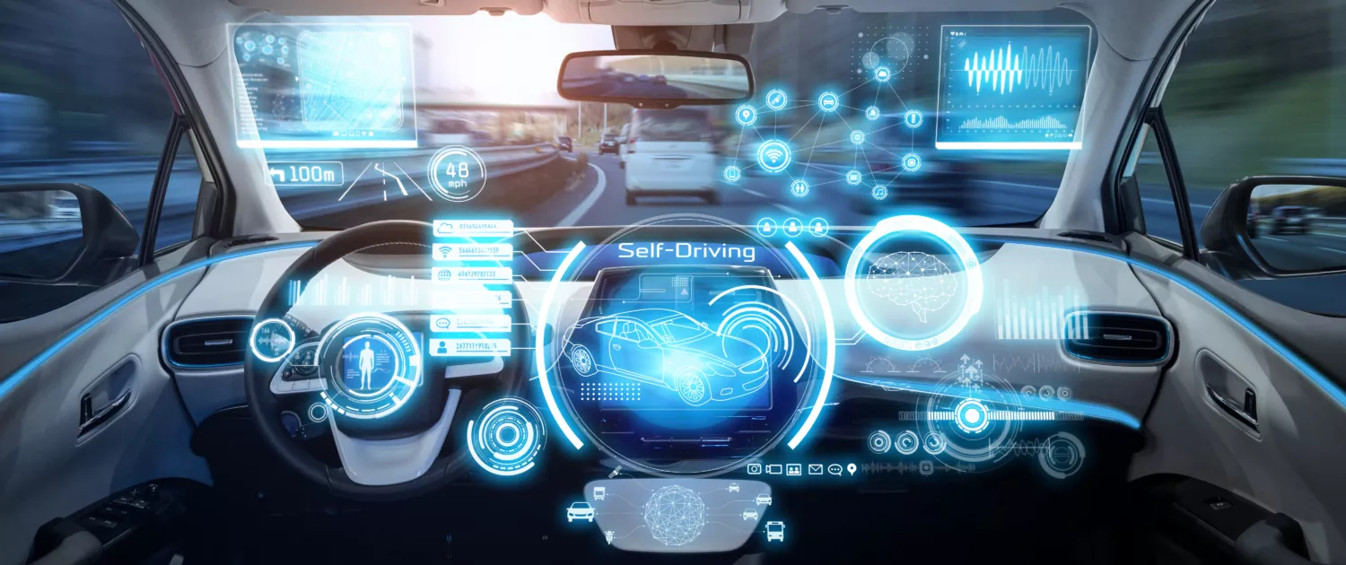
CONCLUSION AND FUTURE SCOPE
This robot is able to produce the basic walking movements using two gear motors. They developed the robot with a very good intelligence which is easily capable to sense the obstacle and by processing the signal coming from the sensor it is perfectly avoiding the obstacle coming in the path.

Slide 12
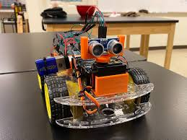
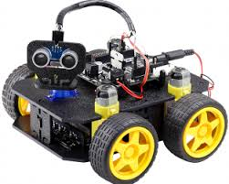
Thank You
K.VENKAT(20241A0324)
J.SAIKISHORE(21245A0303)
J.SHANMUKH(20241A0319)

